Slide 1


Women++ KPI App Project
KNIGHTS OF PERFORMANCE INSIGHTS

Slide 2

THE CHALLENGE
A world dominated by excel nightmares

Slide 3



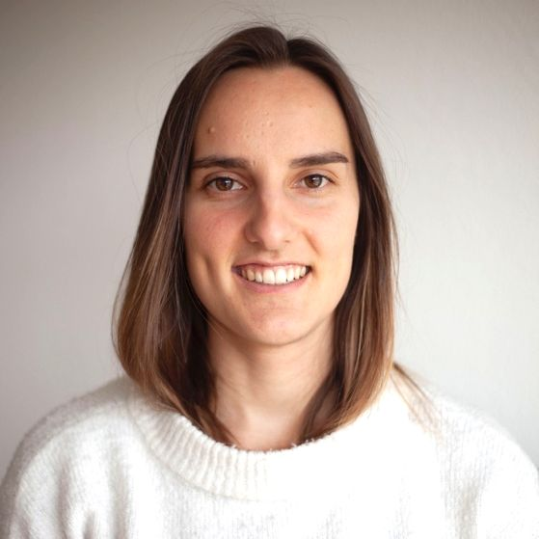



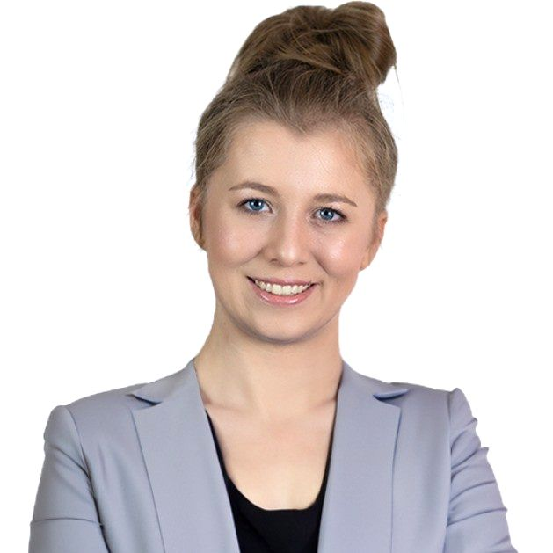
THE TEAM OF HEROES
Knights of Performance Insights
Mighty Management Miren
Yara Agile Avenger
Graphics Artificer Mariana
User Flow Hero Elisabeth
Data Wizard Diana
Michael Sabre
Database Whisperer Mohamed
Alina Codeblade Guardian

Slide 4
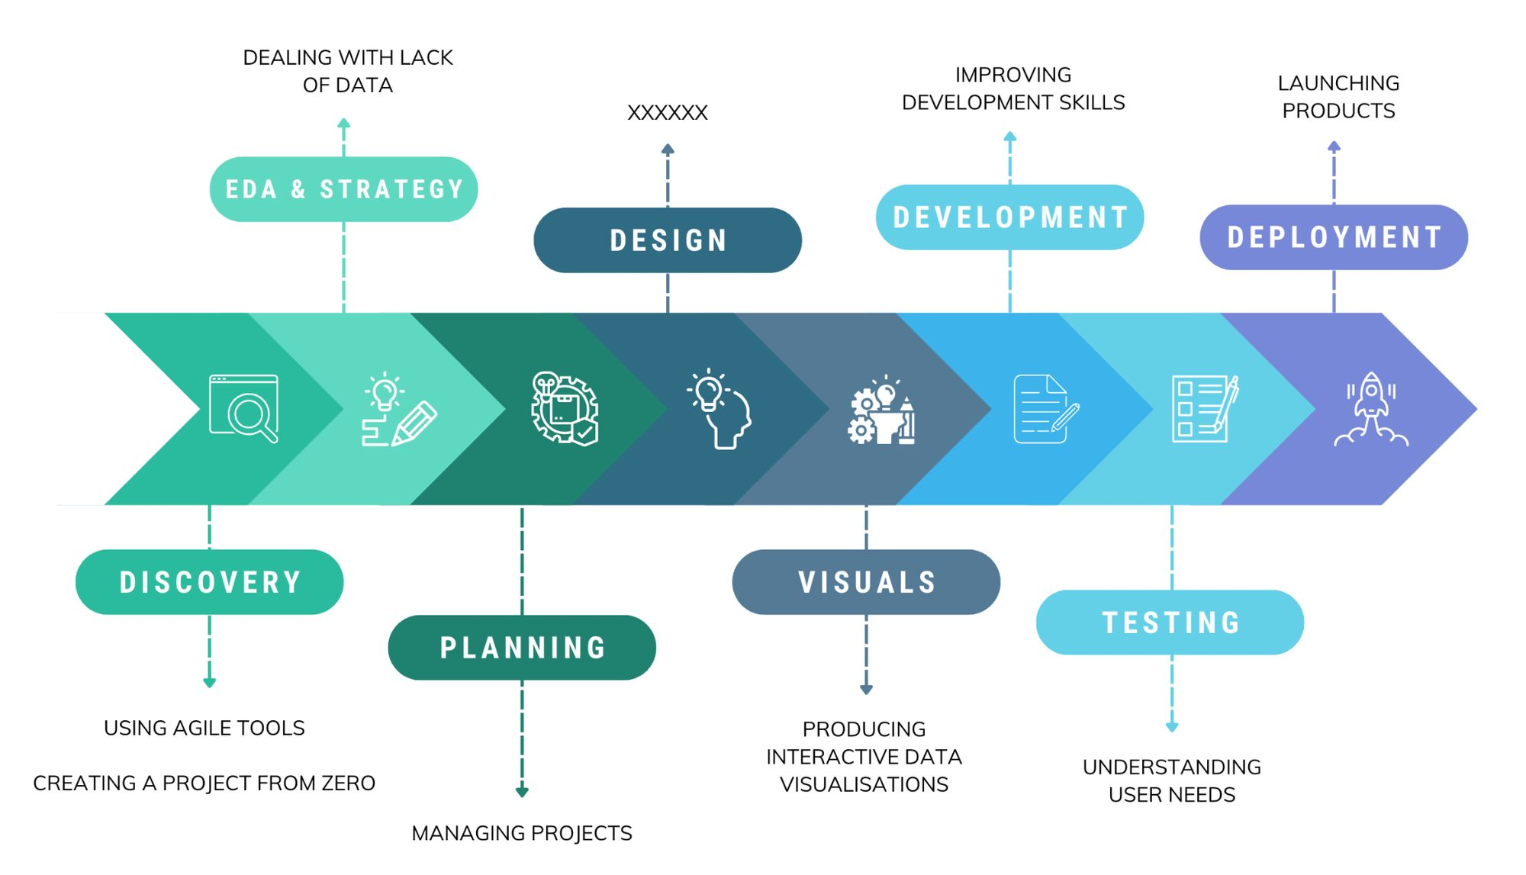
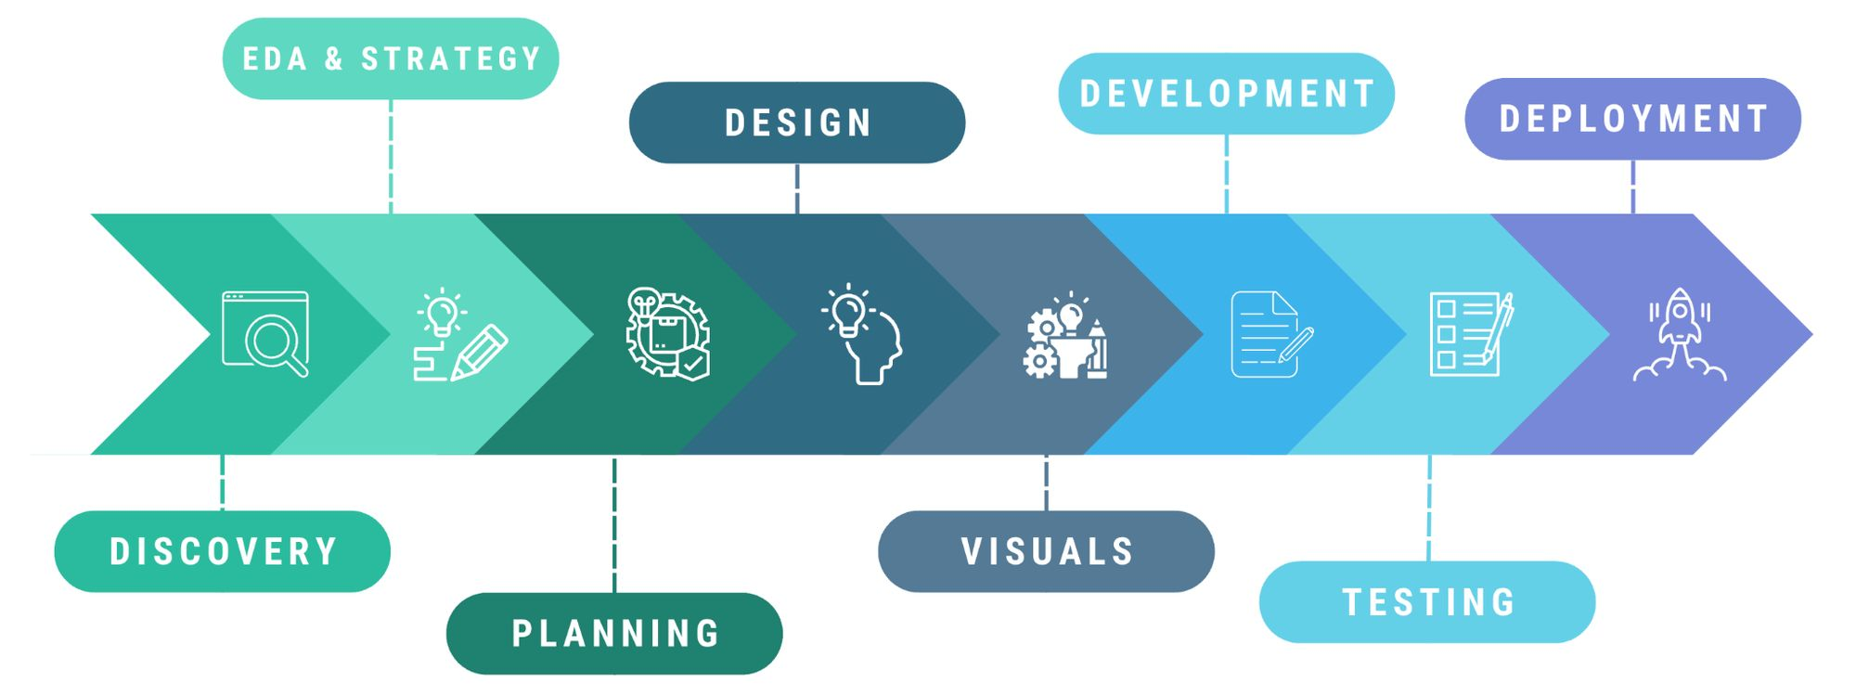
Our journey and what we've learnt

Slide 5
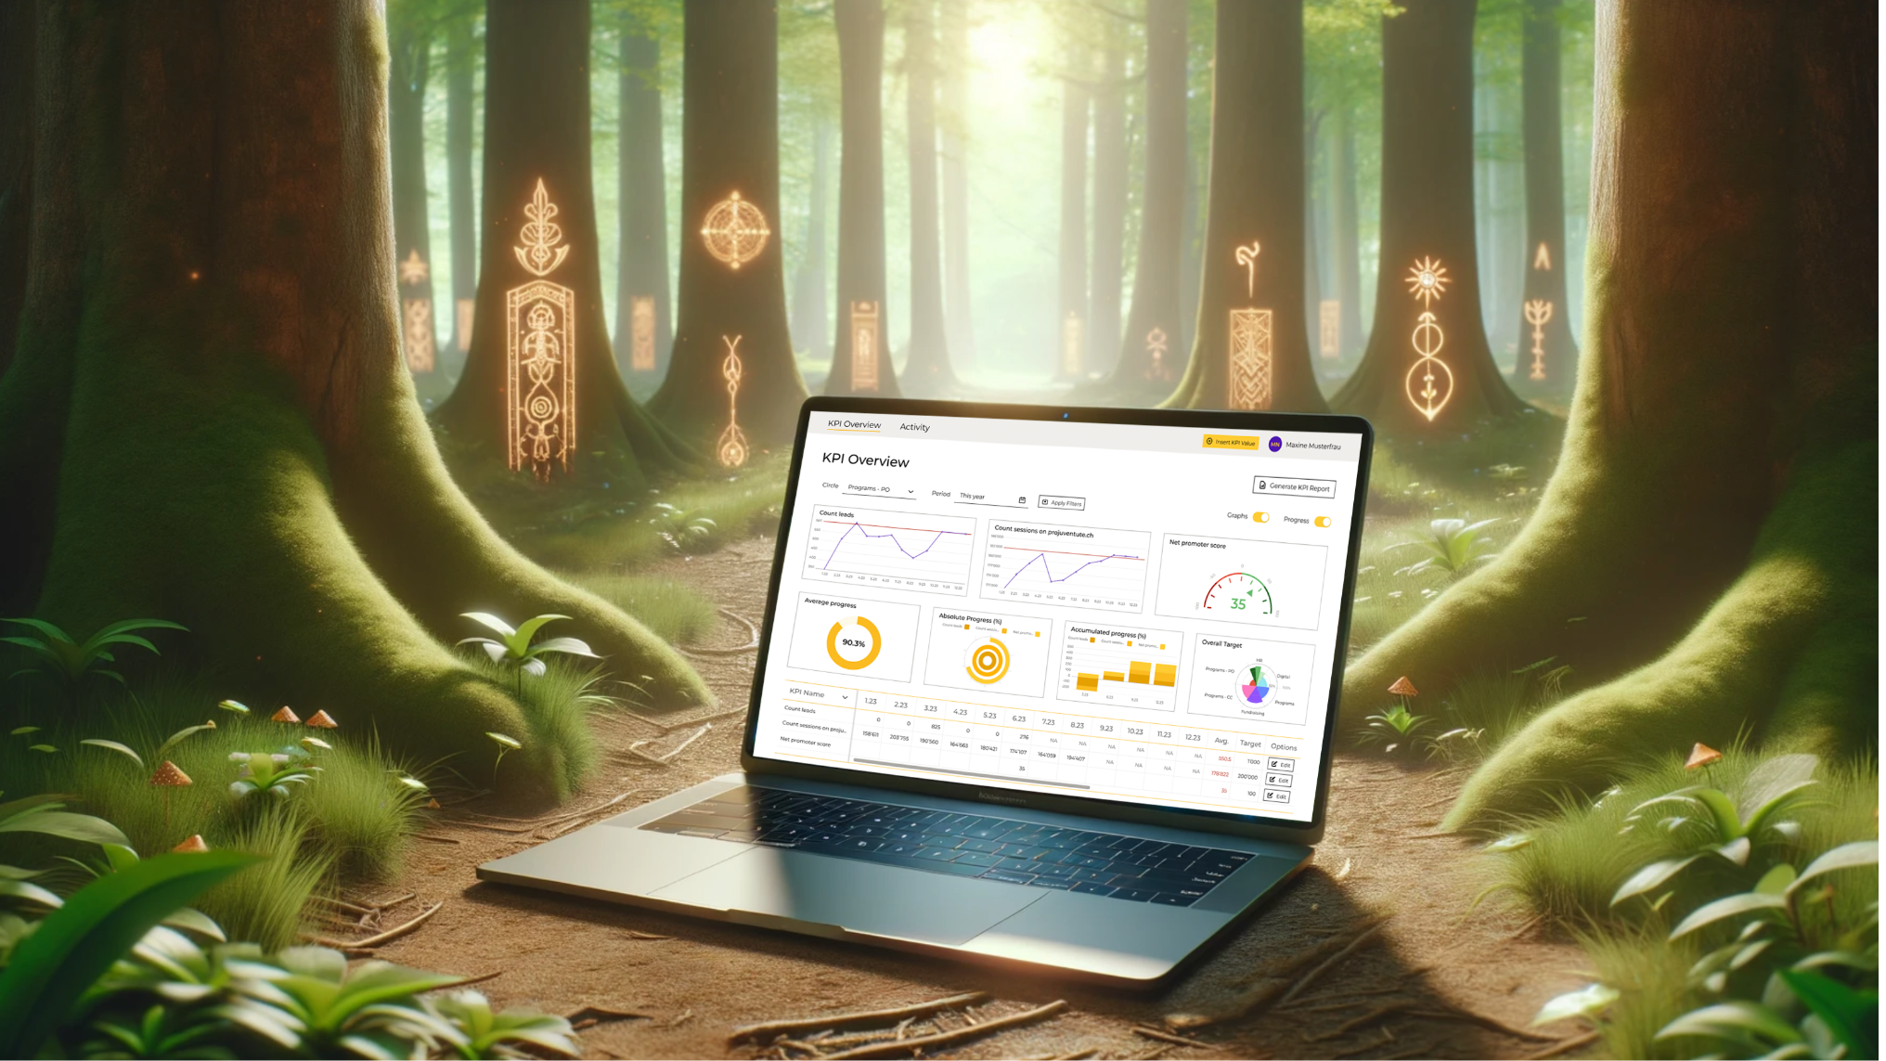
The magic weapon
Here comes our magic!

Slide 6
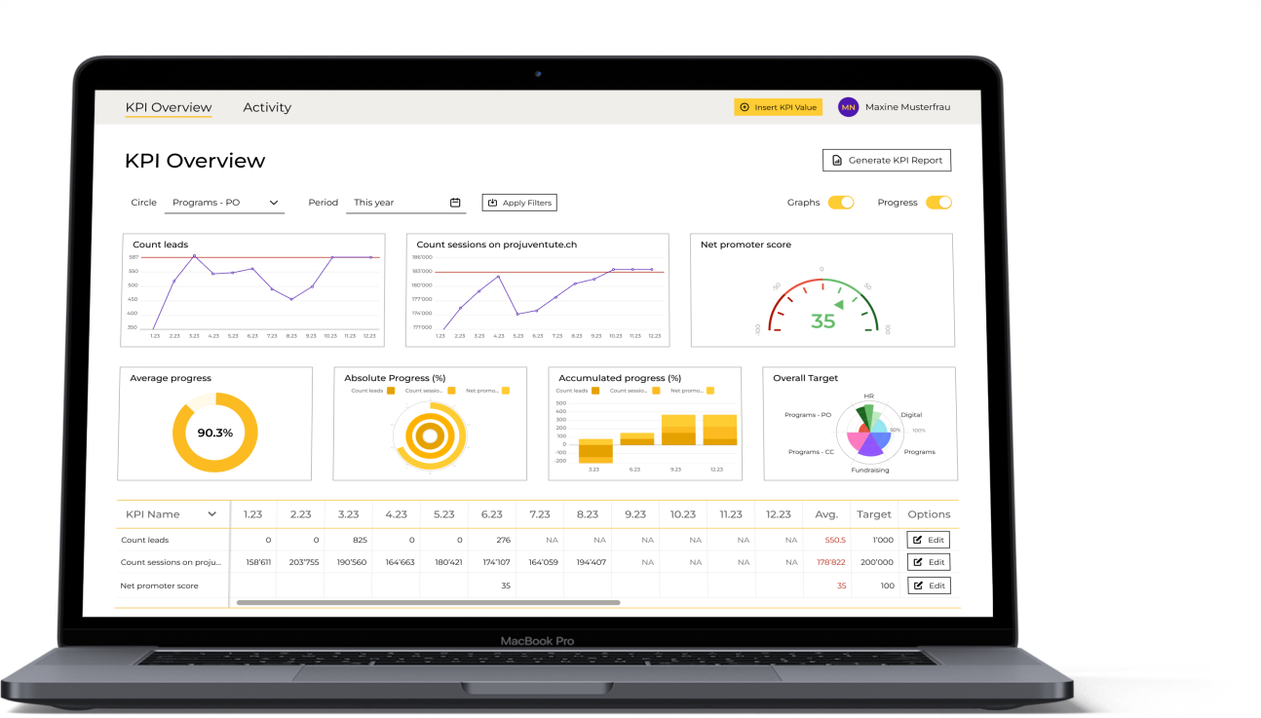




Tools for the Economists
Single sign-on system
Easy-to-use input mode
Tailored data overview
Handy activity
log
Notes:
Slide 5 : Economist features
Title → Tools for the Economists {35 secs}
Pitch: Economist won't have to worry any longer about getting lost with data input and not knowing how they are progressing. We offer (them) the Economists: A Single sign-on system, a tailored data overview, an easy-to-use input mode, and a handy activity log. Economists can choose between Three visualisation types: actual data plots, progress report per circle and a holistic dashboard for all Projuventute.

Slide 7

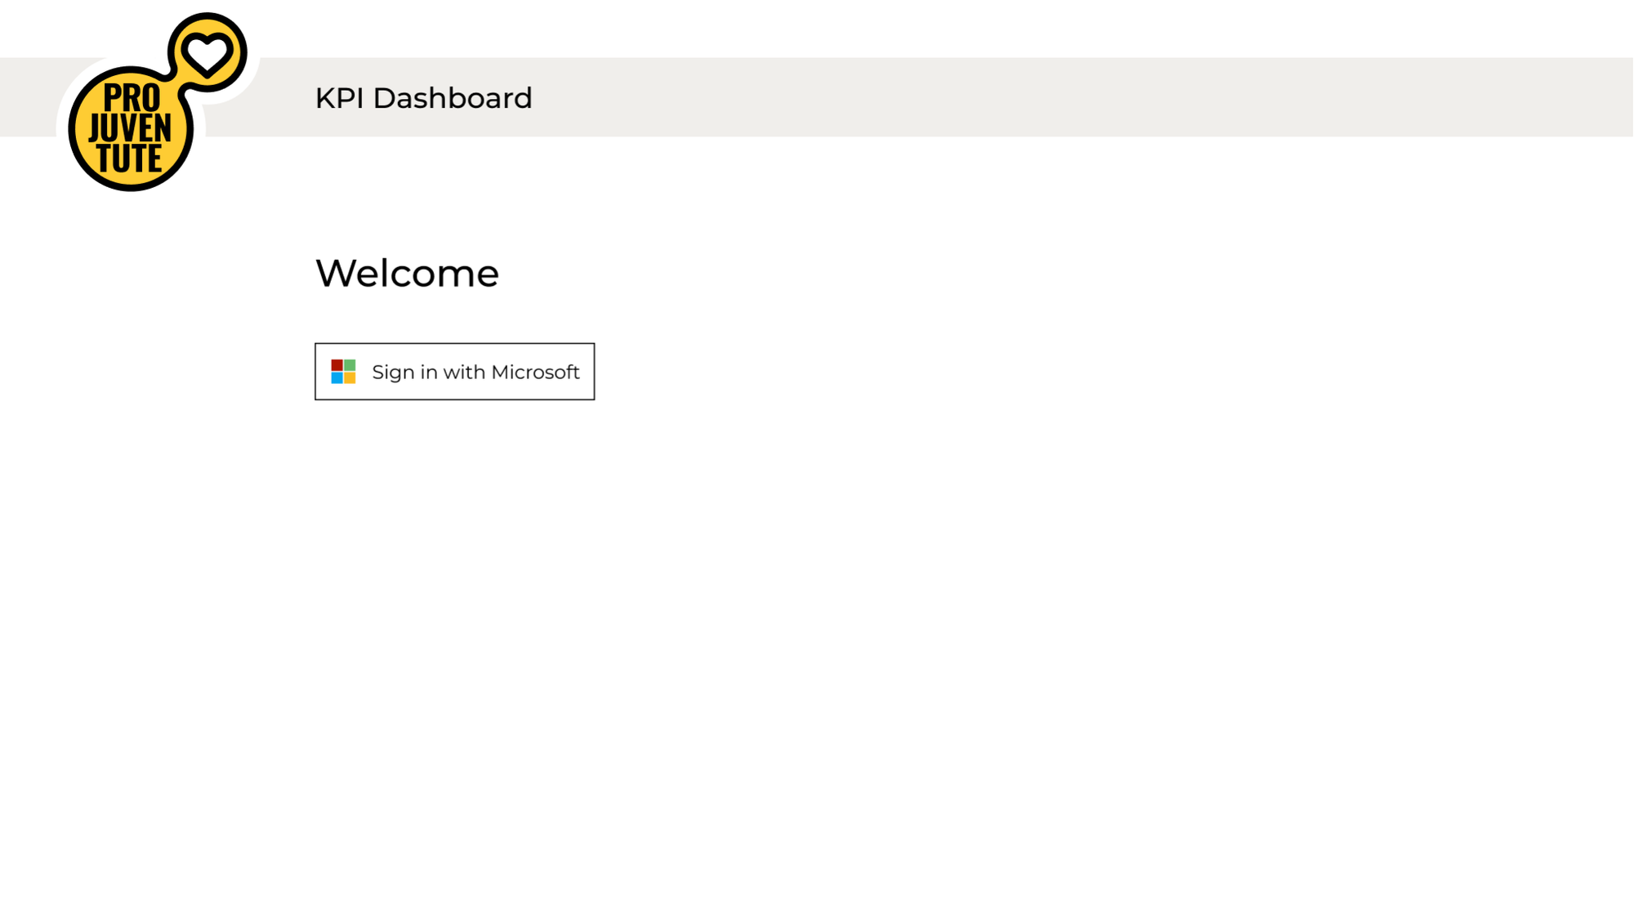
Single Sign-on
Notes:
Slide 5 : Economist features
Title → Tools for the Economists {35 secs}
Pitch: Economist won't have to worry any longer about getting lost with data input and not knowing how they are progressing. We offer (them) the Economists: A Single sign-on system, a tailored data overview, an easy-to-use input mode, and a handy activity log. Economists can choose between Three visualisation types: actual data plots, progress report per circle and a holistic dashboard for all Projuventute.

Slide 8
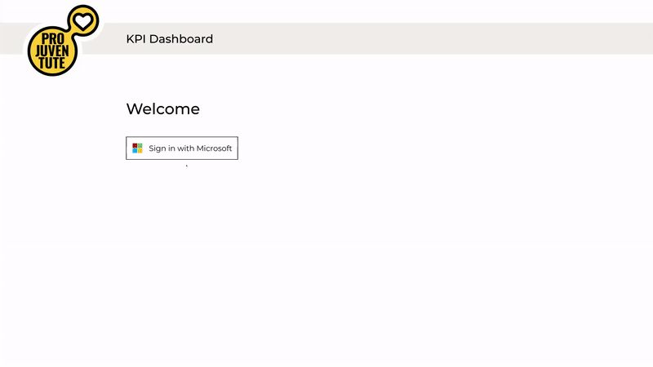
Single Sign-on
Notes:
Slide 5 : Economist features
Title → Tools for the Economists {35 secs}
Pitch: Economist won't have to worry any longer about getting lost with data input and not knowing how they are progressing. We offer (them) the Economists: A Single sign-on system, a tailored data overview, an easy-to-use input mode, and a handy activity log. Economists can choose between Three visualisation types: actual data plots, progress report per circle and a holistic dashboard for all Projuventute.

Slide 9
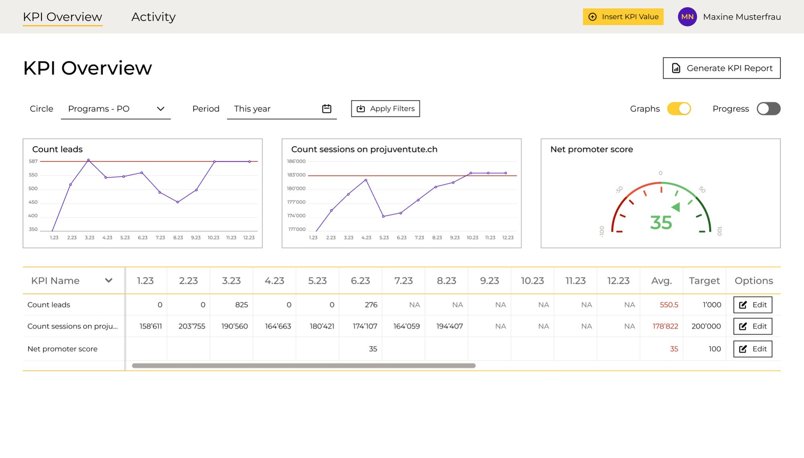
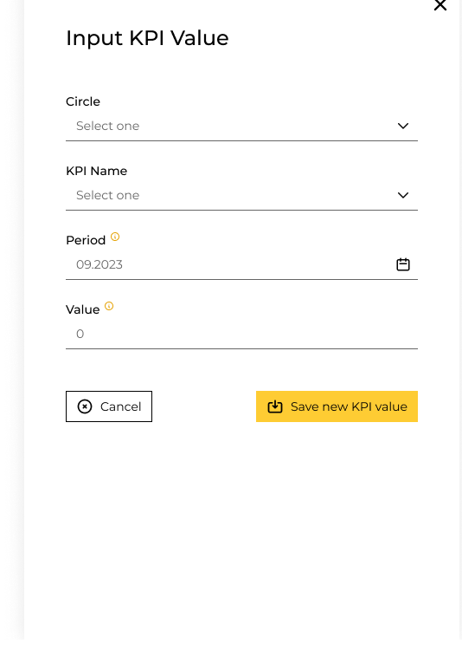
Simple KPI input modal
Notes:
Slide 5 : Economist features
Title → Tools for the Economists {35 secs}
Pitch: Economist won't have to worry any longer about getting lost with data input and not knowing how they are progressing. We offer (them) the Economists: A Single sign-on system, a tailored data overview, an easy-to-use input mode, and a handy activity log. Economists can choose between Three visualisation types: actual data plots, progress report per circle and a holistic dashboard for all Projuventute.

Slide 10
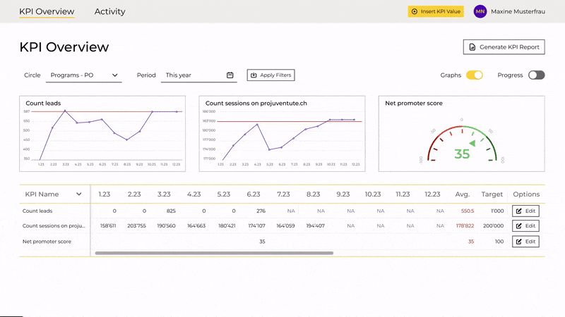
Simple KPI input modal
Notes:
Slide 5 : Economist features
Title → Tools for the Economists {35 secs}
Pitch: Economist won't have to worry any longer about getting lost with data input and not knowing how they are progressing. We offer (them) the Economists: A Single sign-on system, a tailored data overview, an easy-to-use input mode, and a handy activity log. Economists can choose between Three visualisation types: actual data plots, progress report per circle and a holistic dashboard for all Projuventute.

Slide 11
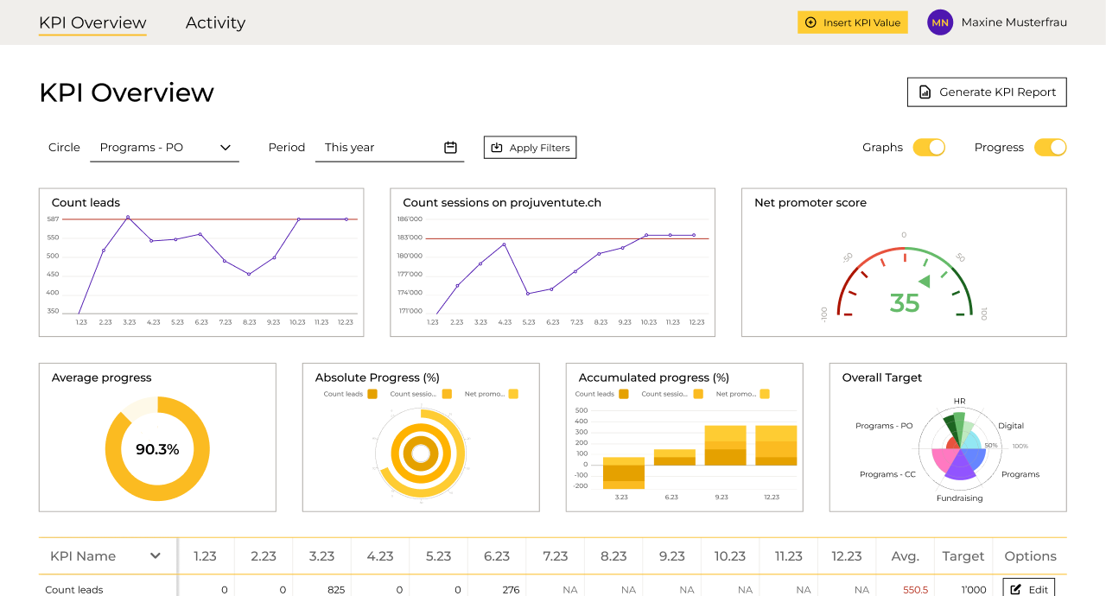
Customized data overview
Notes:
Slide 5 : Economist features
Title → Tools for the Economists {35 secs}
Pitch: Economist won't have to worry any longer about getting lost with data input and not knowing how they are progressing. We offer (them) the Economists: A Single sign-on system, a tailored data overview, an easy-to-use input mode, and a handy activity log. Economists can choose between Three visualisation types: actual data plots, progress report per circle and a holistic dashboard for all Projuventute.

Slide 12
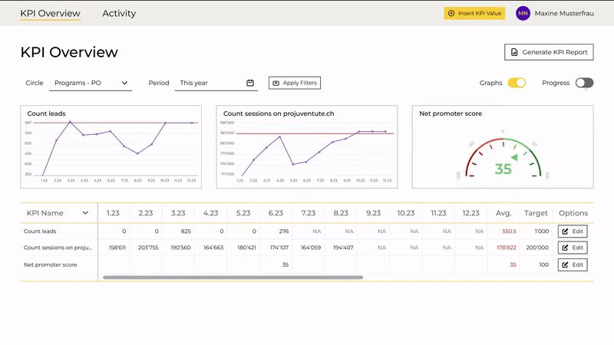
Customized data overview
Notes:
Slide 5 : Economist features
Title → Tools for the Economists {35 secs}
Pitch: Economist won't have to worry any longer about getting lost with data input and not knowing how they are progressing. We offer (them) the Economists: A Single sign-on system, a tailored data overview, an easy-to-use input mode, and a handy activity log. Economists can choose between Three visualisation types: actual data plots, progress report per circle and a holistic dashboard for all Projuventute.

Slide 13
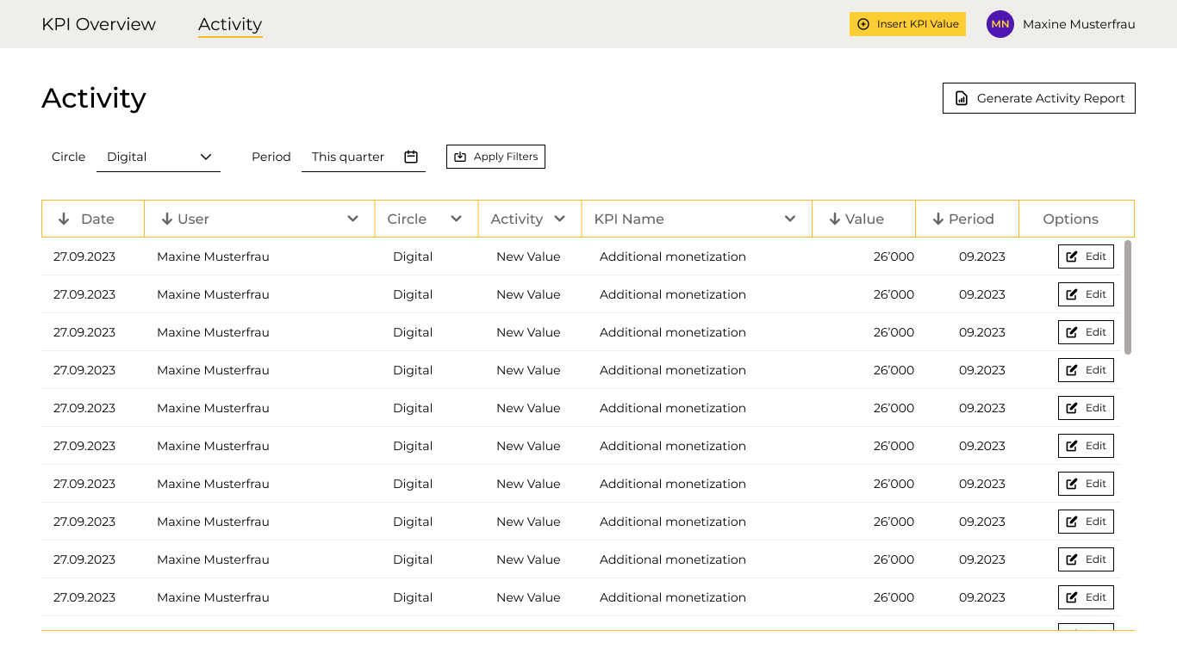
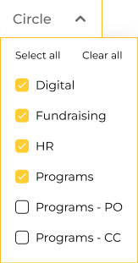
Accessible Activity log
Notes:
Slide 5 : Economist features
Title → Tools for the Economists {35 secs}
Pitch: Economist won't have to worry any longer about getting lost with data input and not knowing how they are progressing. We offer (them) the Economists: A Single sign-on system, a tailored data overview, an easy-to-use input mode, and a handy activity log. Economists can choose between Three visualisation types: actual data plots, progress report per circle and a holistic dashboard for all Projuventute.

Slide 14
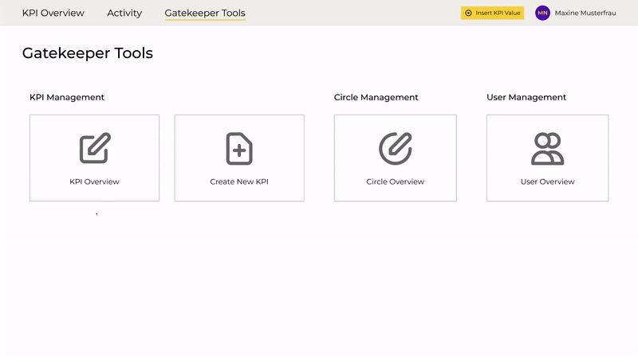




Gatekeeper’s
toolbox
Complete progress overview
Assistance in creating KPI’s
KPI management
Overview of circles and users
Notes:
Slide 6 : Gatekeeper features
Title → Martin's Toolbox {60 secs}
Pitch: For Martin, our Gatekeeper, we've got: A complete progress overview, special tools tailored for his role, assistance in creating KPIs, KPI management, and an overview of circles and users.
The complete progress and performance tracking overview, will help him know better how to motivate his people.
The KPI creation menu offers full flexibility, as we have thought of all possible options and units that would be required to create any future KPI.
The KPI management screen will help him keep track of all created KPIs
The overview of circles and users, will in the same manner help him know who inputs data where and when.

Slide 15
Gatekeeper tools
Notes:
Slide 6 : Gatekeeper features
Title → Martin's Toolbox {60 secs}
Pitch: For Martin, our Gatekeeper, we've got: A complete progress overview, special tools tailored for his role, assistance in creating KPIs, KPI management, and an overview of circles and users.
The complete progress and performance tracking overview, will help him know better how to motivate his people.
The KPI creation menu offers full flexibility, as we have thought of all possible options and units that would be required to create any future KPI.
The KPI management screen will help him keep track of all created KPIs
The overview of circles and users, will in the same manner help him know who inputs data where and when.

Slide 16
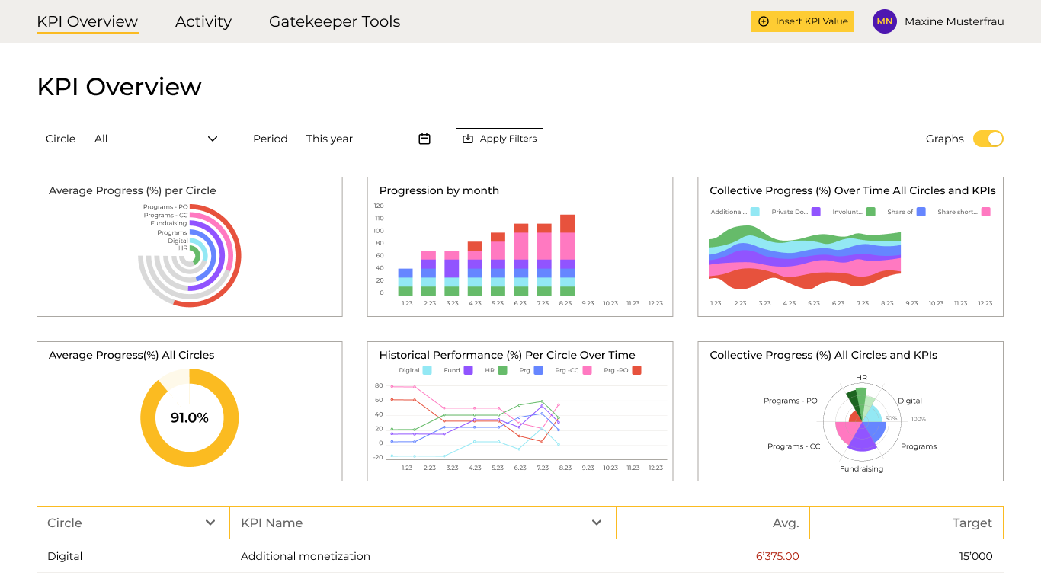
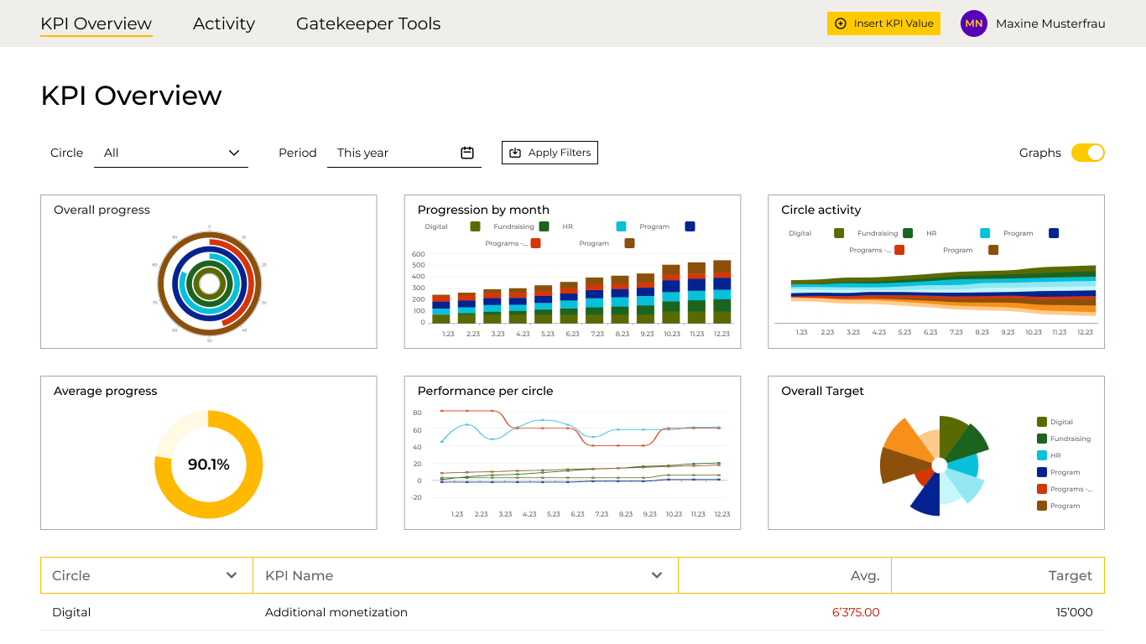
Holistic Progress Overview
Notes:
Slide 6 : Gatekeeper features
Title → Martin's Toolbox {60 secs}
Pitch: For Martin, our Gatekeeper, we've got: A complete progress overview, special tools tailored for his role, assistance in creating KPIs, KPI management, and an overview of circles and users.
The complete progress and performance tracking overview, will help him know better how to motivate his people.
The KPI creation menu offers full flexibility, as we have thought of all possible options and units that would be required to create any future KPI.
The KPI management screen will help him keep track of all created KPIs
The overview of circles and users, will in the same manner help him know who inputs data where and when.

Slide 17
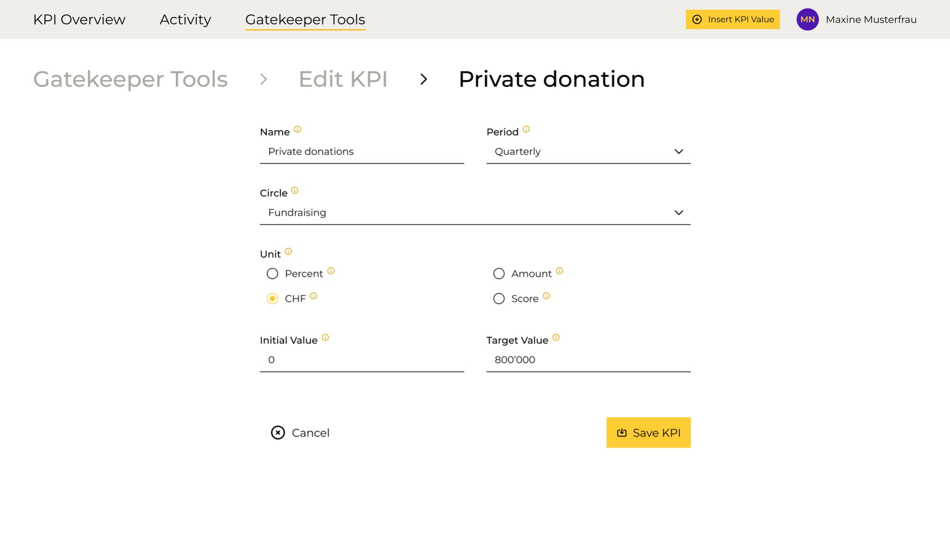
Guided KPI creation
Notes:
Slide 6 : Gatekeeper features
Title → Martin's Toolbox {60 secs}
Pitch: For Martin, our Gatekeeper, we've got: A complete progress overview, special tools tailored for his role, assistance in creating KPIs, KPI management, and an overview of circles and users.
The complete progress and performance tracking overview, will help him know better how to motivate his people.
The KPI creation menu offers full flexibility, as we have thought of all possible options and units that would be required to create any future KPI.
The KPI management screen will help him keep track of all created KPIs
The overview of circles and users, will in the same manner help him know who inputs data where and when.

Slide 18
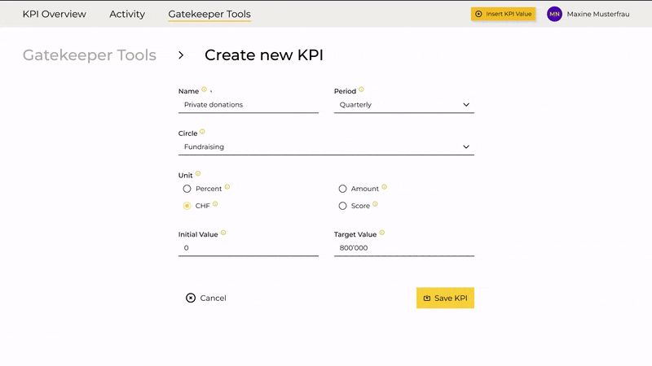
Guided KPI creation
Notes:
Slide 6 : Gatekeeper features
Title → Martin's Toolbox {60 secs}
Pitch: For Martin, our Gatekeeper, we've got: A complete progress overview, special tools tailored for his role, assistance in creating KPIs, KPI management, and an overview of circles and users.
The complete progress and performance tracking overview, will help him know better how to motivate his people.
The KPI creation menu offers full flexibility, as we have thought of all possible options and units that would be required to create any future KPI.
The KPI management screen will help him keep track of all created KPIs
The overview of circles and users, will in the same manner help him know who inputs data where and when.

Slide 19
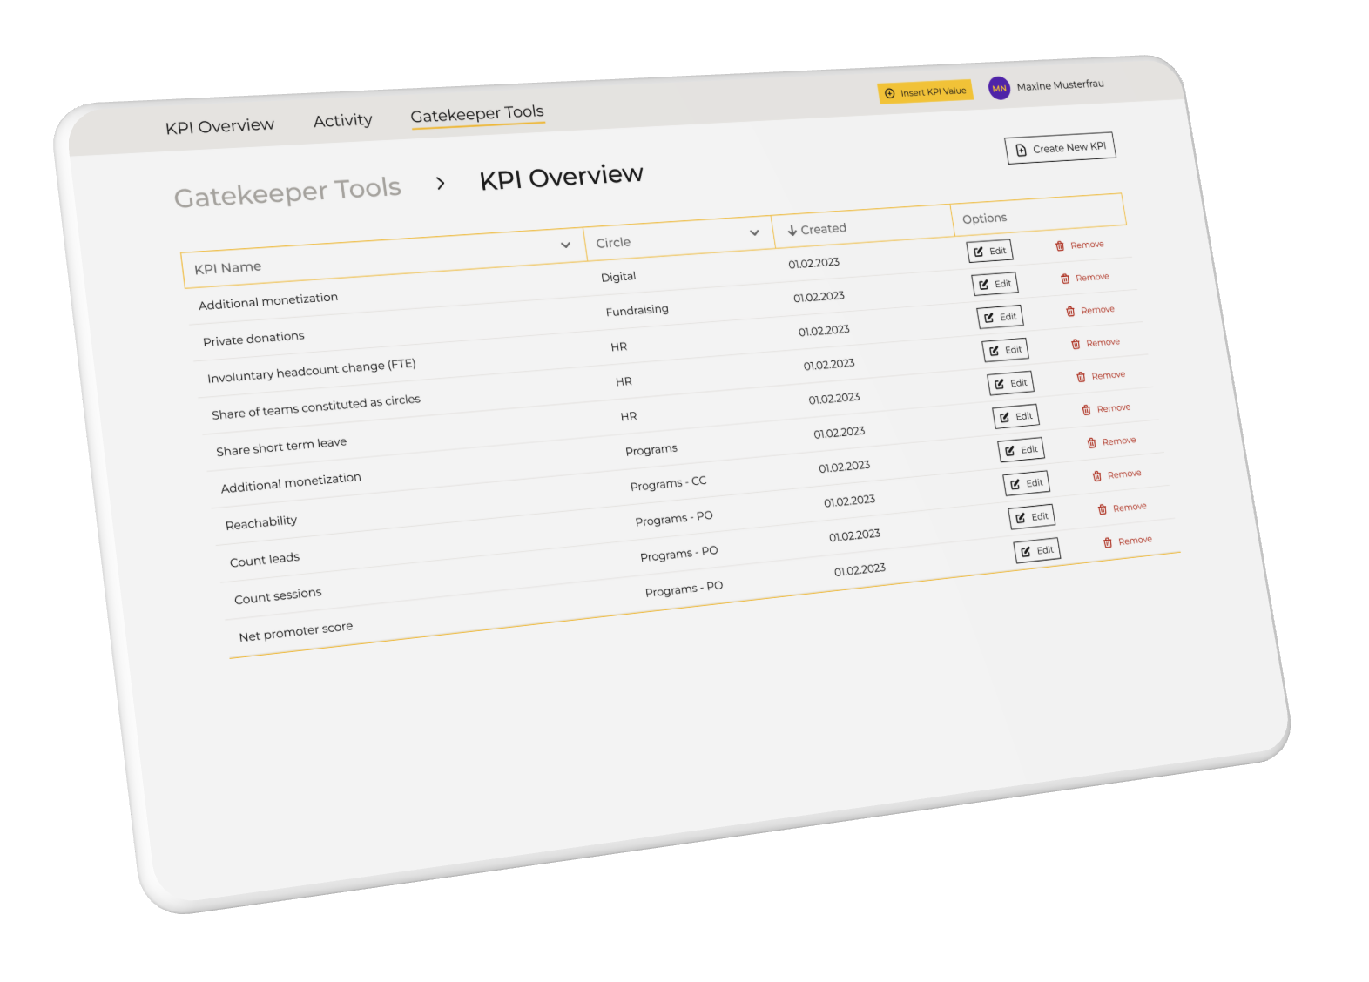
KPI Management

Slide 20
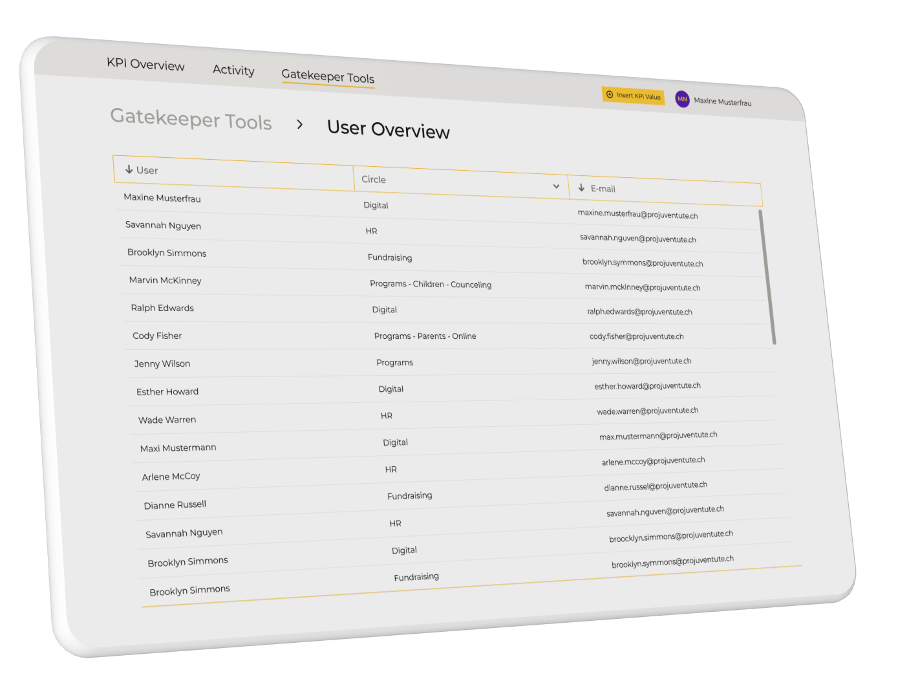
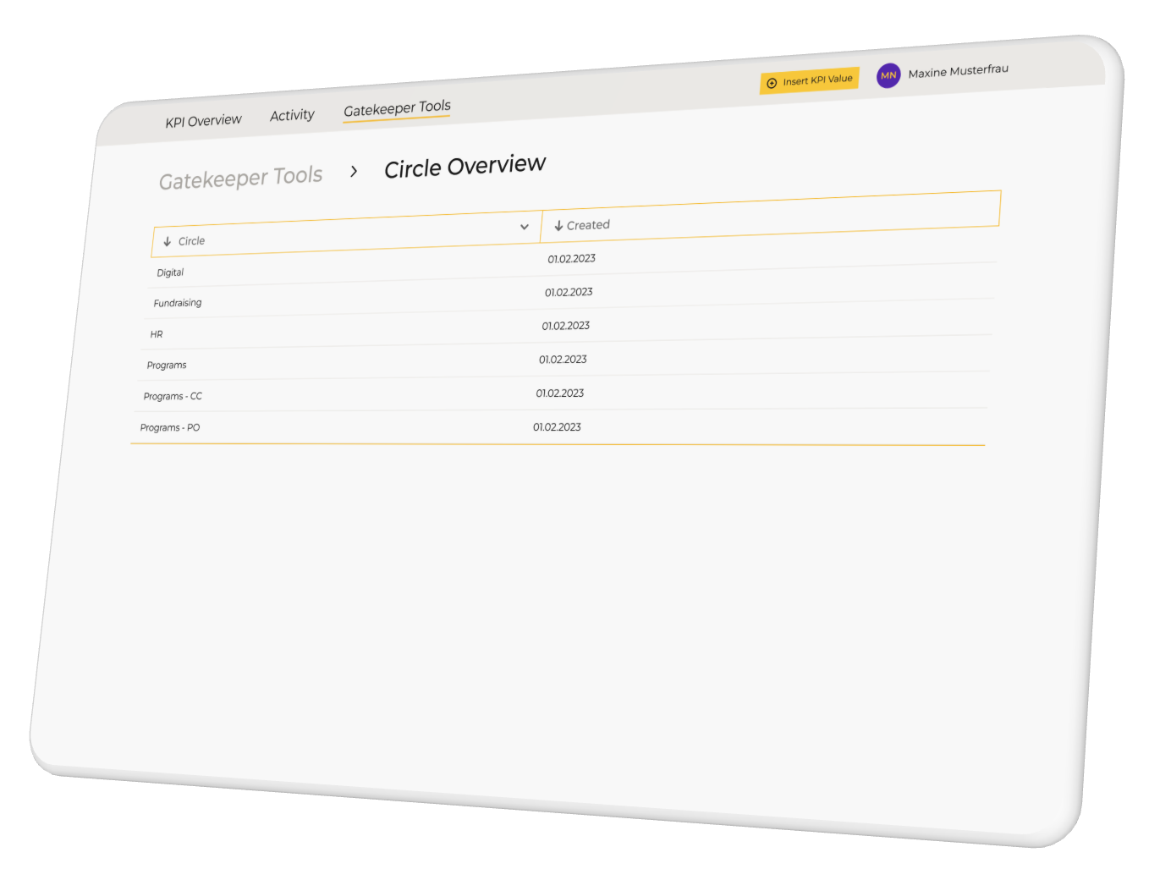
Circle and User overview

Slide 21
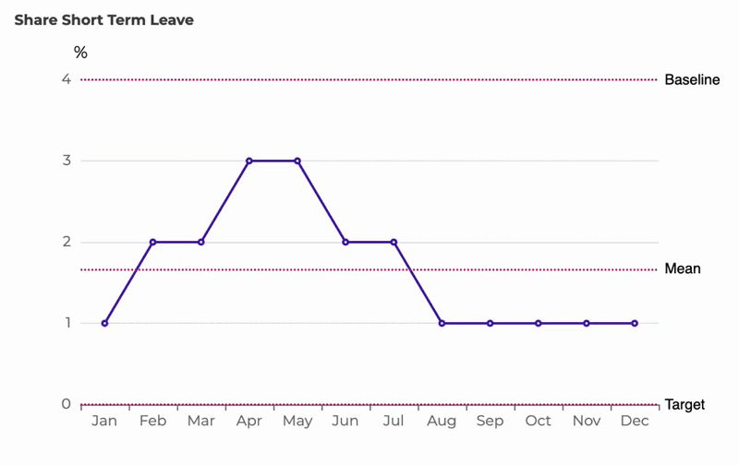
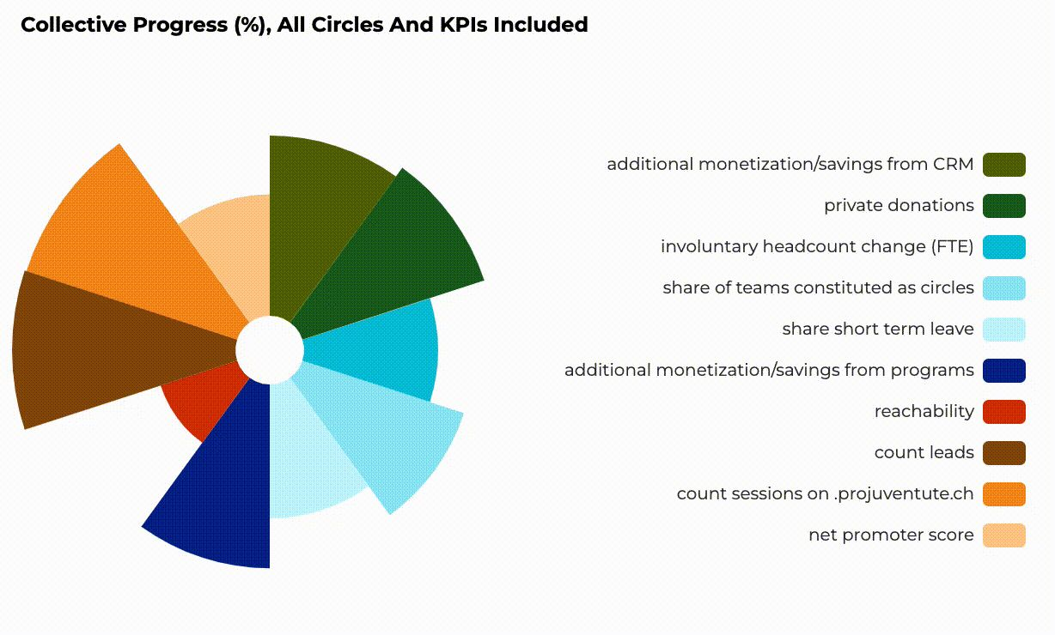
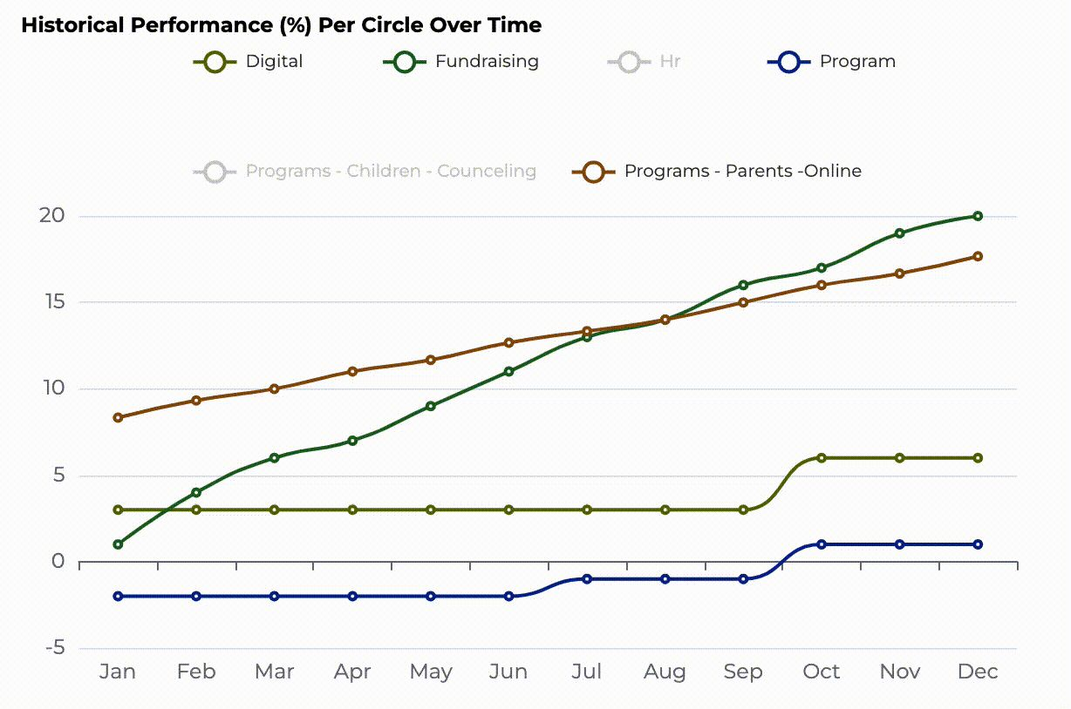
Data and Viz Features
Cumulative and incremental viz based on KPI type
Interactive viz and selective legends
Metrics of Progress and Performance
Notes:
Slide 6 : Gatekeeper features
Title → Martin's Toolbox {60 secs}
Pitch: For Martin, our Gatekeeper, we've got: A complete progress overview, special tools tailored for his role, assistance in creating KPIs, KPI management, and an overview of circles and users.
The complete progress and performance tracking overview, will help him know better how to motivate his people.
The KPI creation menu offers full flexibility, as we have thought of all possible options and units that would be required to create any future KPI.
The KPI management screen will help him keep track of all created KPIs
The overview of circles and users, will in the same manner help him know who inputs data where and when.

Slide 22
What's next?

Slide 23
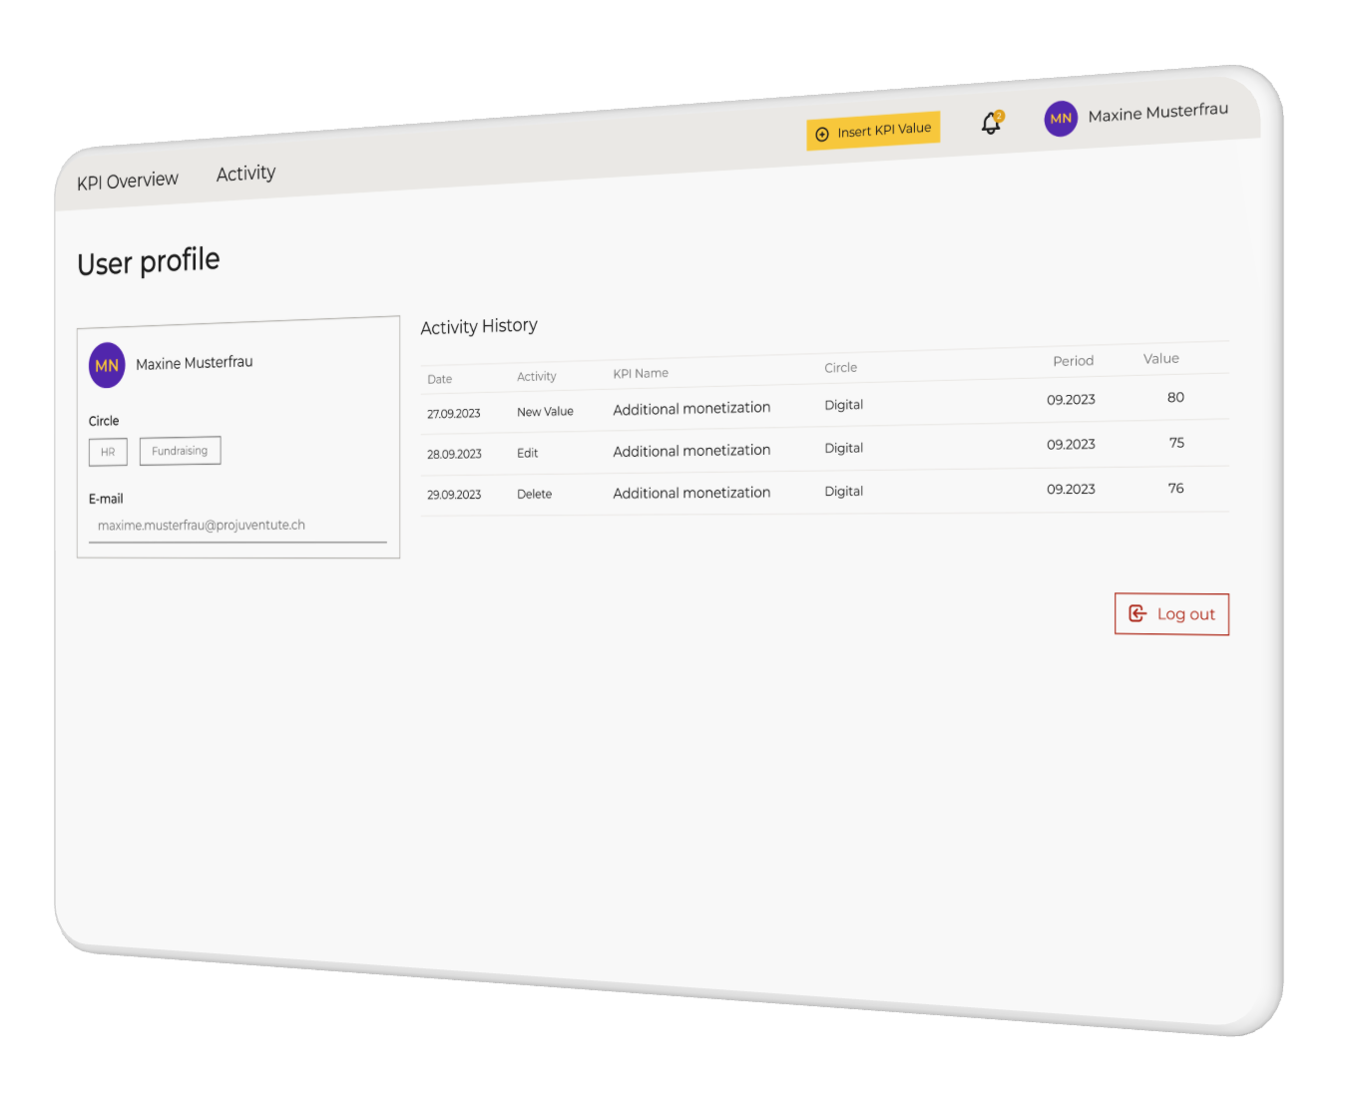
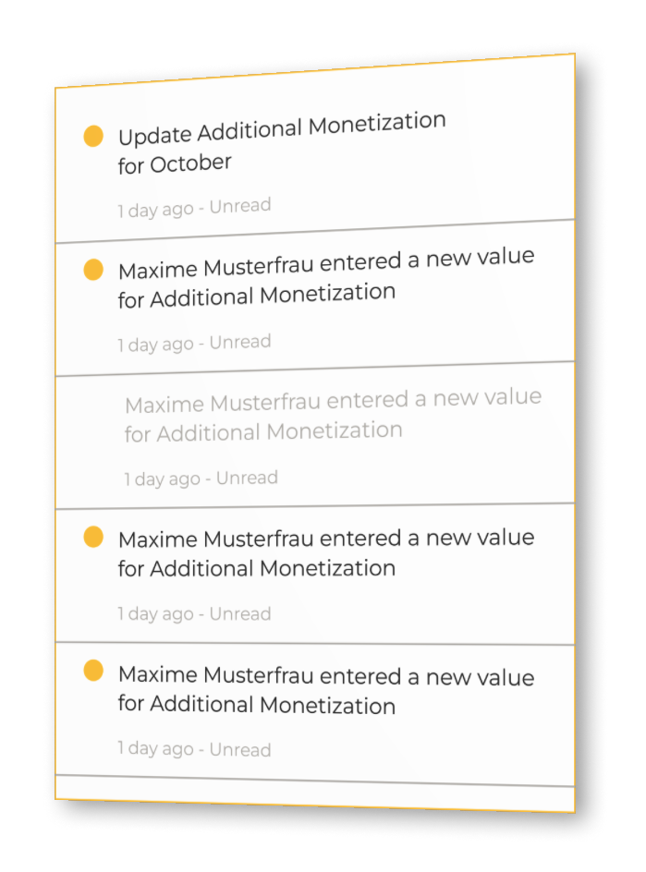
Notifications

Slide 24
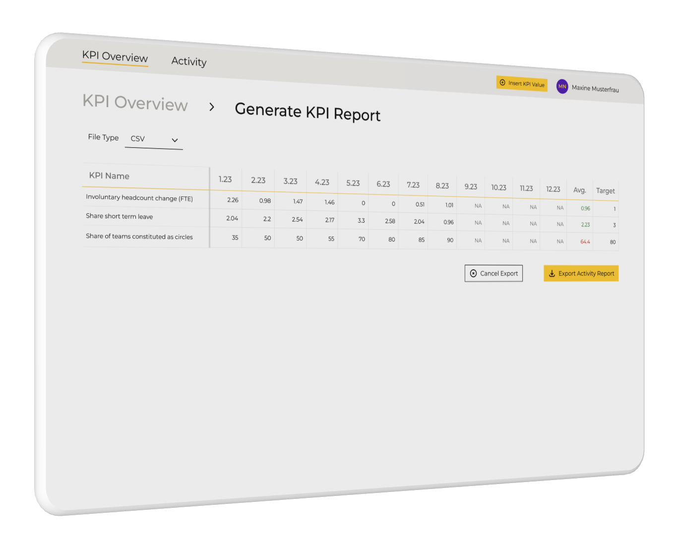

Data Export

Slide 25
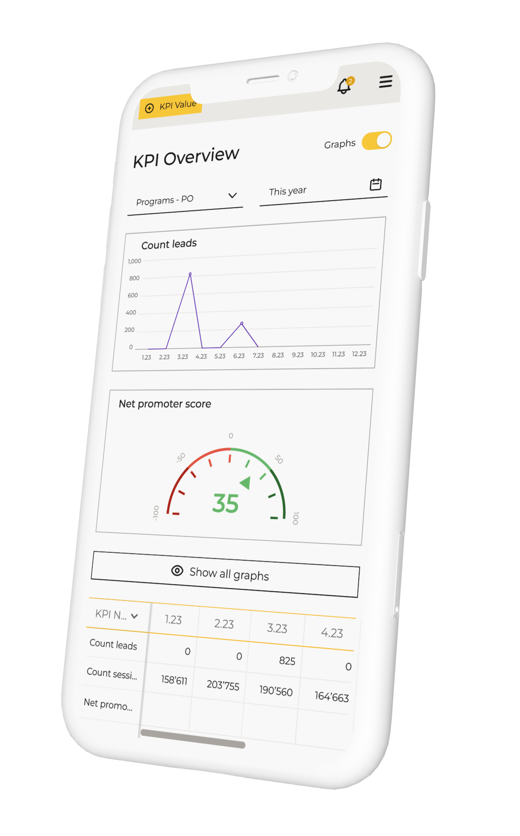
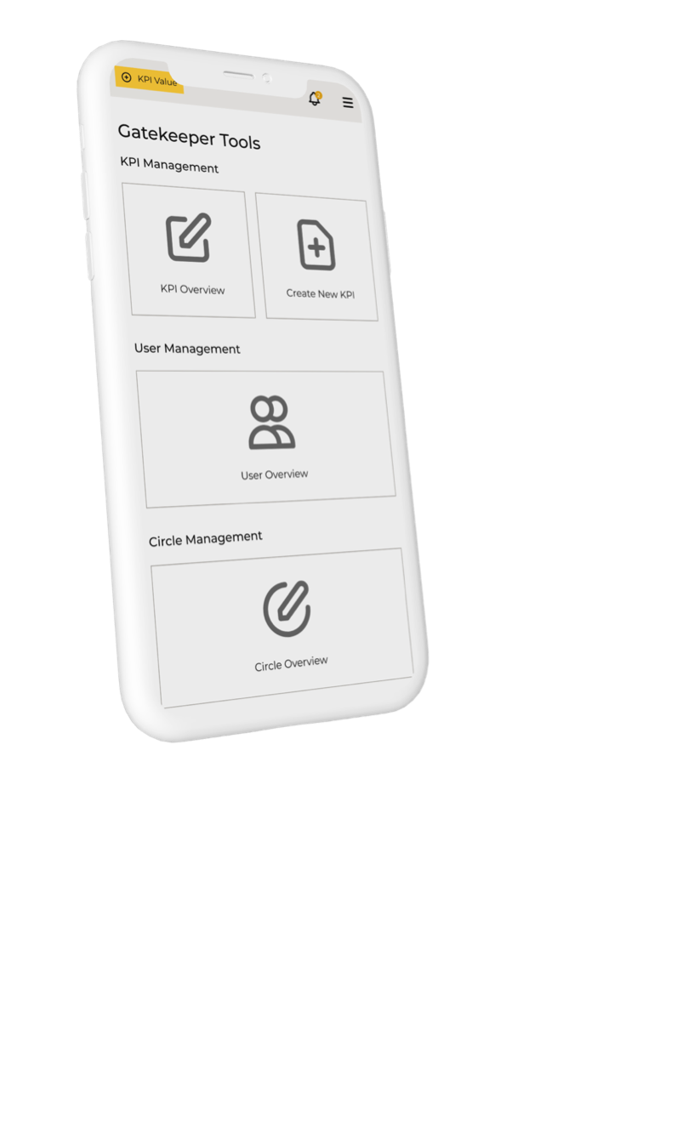
Responsive screen sizing

Slide 26

And this is how the nightmare turns into a fantastic KPI gathering dream

Slide 27






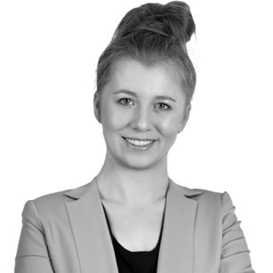
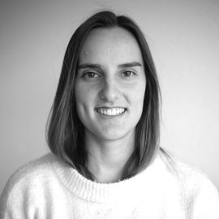

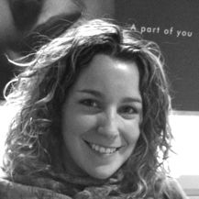
Get in touch with us
Diana Alvarez
Data Scientist
Ke Ma
Michael
Fullstack Deputy
Mohamed Shaaban
Backend Deputy
Mariana Hurtado
UX/UI Lead
Alina Bunn
Fullstack Lead
Elisabeth Saehr
UX/UI Deputy
Yaroslava Kharytonova
Scrum Master
Miren Bengochea
Project Manager
Thanks for listening :)

